Slide 1
Isomap Dimensionality Reduction
DSCI 475 Final Project
By: Kristine Wiggins, Austin Lackey, and Niko DeNiro

Slide 2

Isomap Methodology

Slide 3
Isomap Overview
Dimensionality reduction technique that preserves geodesic distances between data points
Useful for:
Visualizing & analyzing high-dimensional data
Identifying patterns
Compressing data for efficient processing
Real-world uses include analyzing brain activity data, image data, genetic data, audio data, and stock market data

Slide 4
Isometric Mapping
Geodesics - shortest path
k-Nearest Neighbors
Dijkstra’s(SSSP) vs Floyd-Warshall(APSP) algorithm
Eigenvalue Decomposition

Slide 5
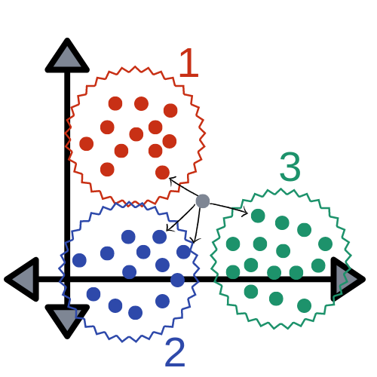
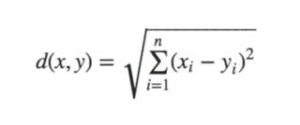
k-Nearest Neighbors (k-NN)

Slide 6
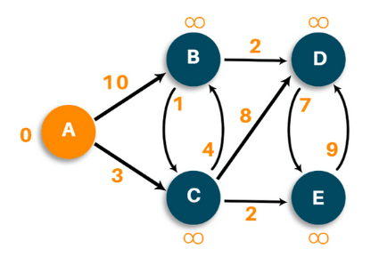
Dijkstra’s Algorithm /
Single Source Shortest Path (SSSP)
distance[v] = min(distance[v], distance[u] + w(u,v))

Slide 7
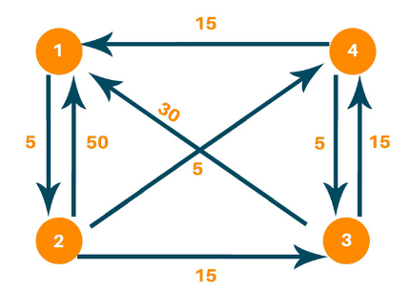
Floyd-Warshall Algorithm / All-Pairs Shortest Paths (APSP)
d[i,j] = min(d[i,j], d[i,k] + d[k,j])

Slide 8
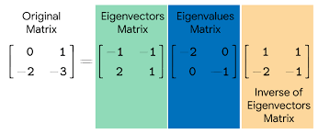
Eigenvalue Decomposition

Slide 9
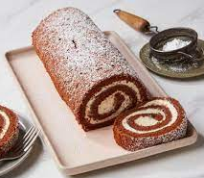
The
Swiss Roll
Image Source: https://www.epicurious.com/recipes/food/views/chocolate-swiss-roll

Slide 10
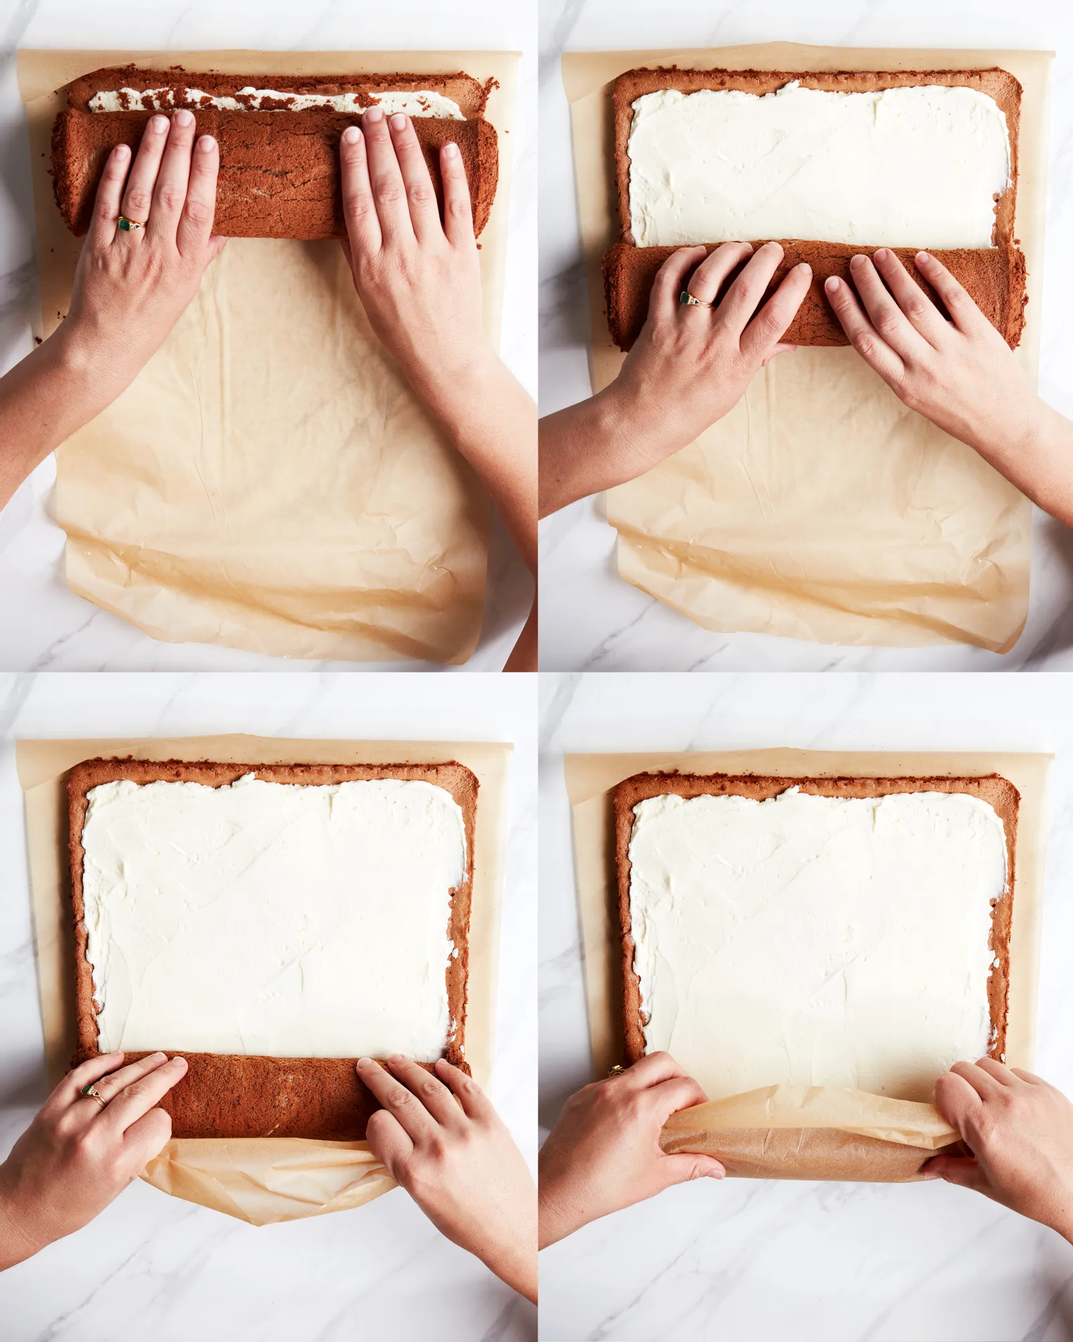
Swiss Roll w/ Isomap
Created theoretical data with scikit-learn’s generated datasets
Complete nonlinear dimensionality reduction with scikit-learn’s Isomap function
Also used same method on a Swiss Roll with a hole in it
Image Source: https://www.epicurious.com/expert-advice/how-to-make-a-swiss-roll-that-doesnt-crack

Slide 11
Code demo

Slide 12
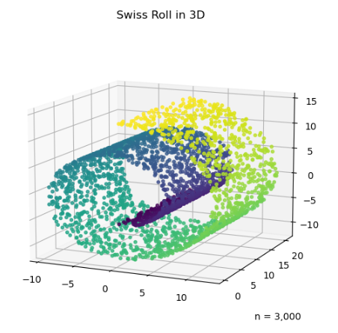
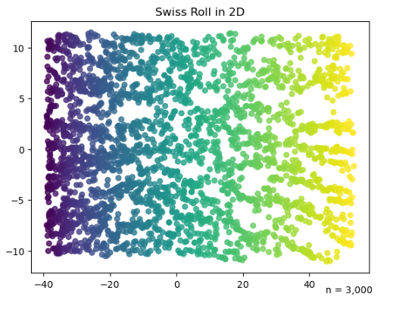

Slide 13
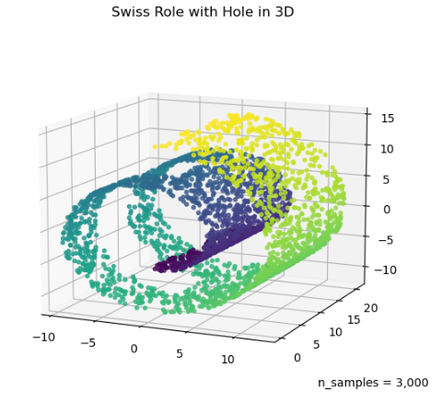
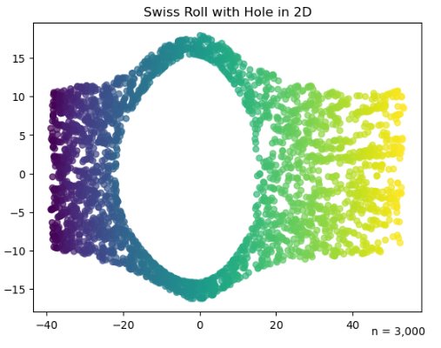

Slide 14
Facial Emotions

Slide 15







Facial Emotions w/ Isomap
Images split into 7 different emotions
Angry, Disgust, Fear, Happy, Neutral, Sad, Surprise

Slide 16
Code demo

Slide 17
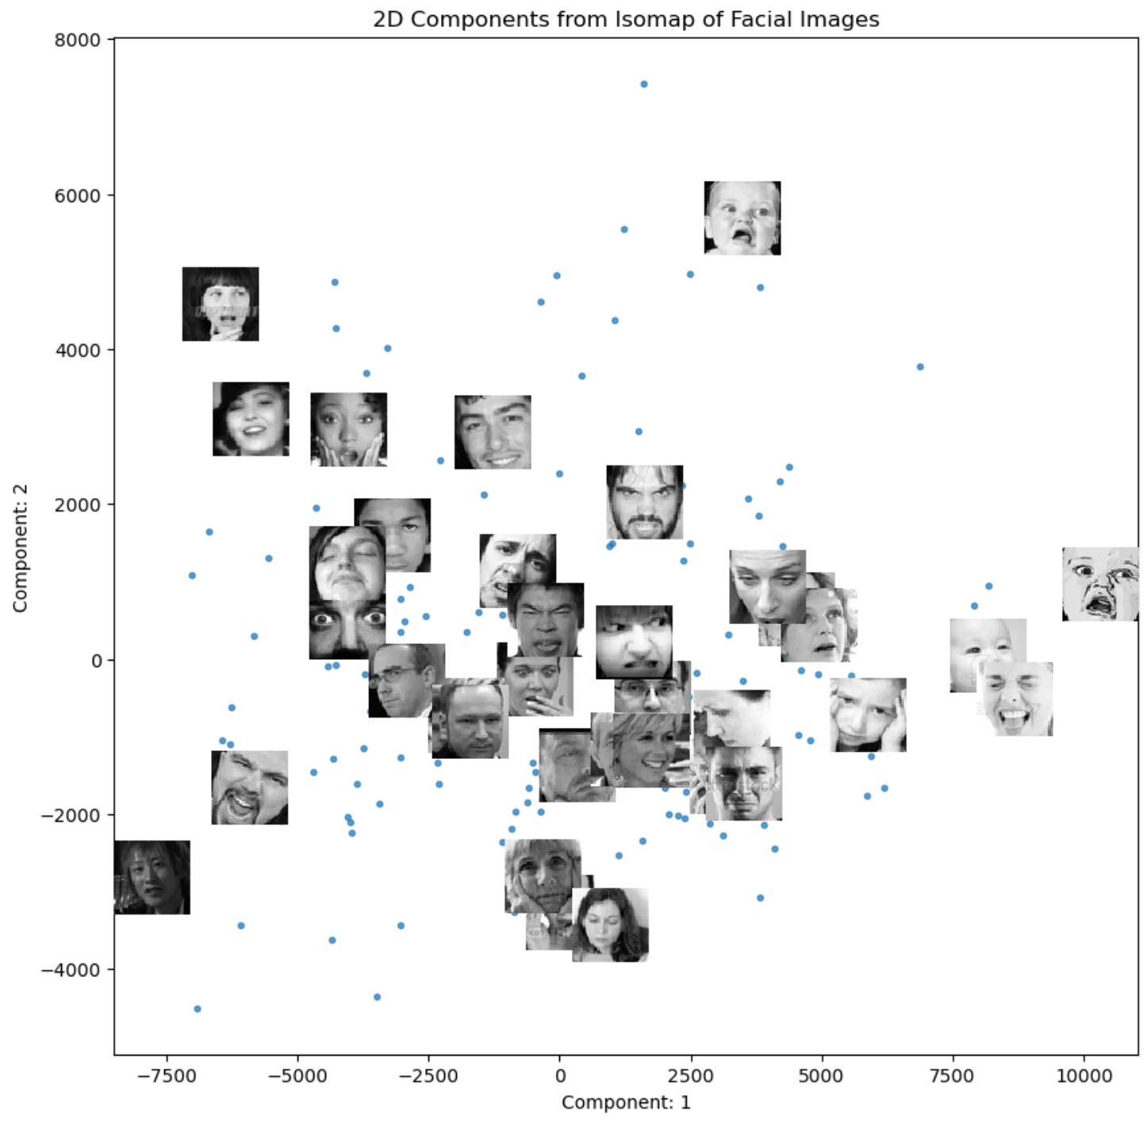

Slide 18
Fruit & Vegetable Images

Slide 19
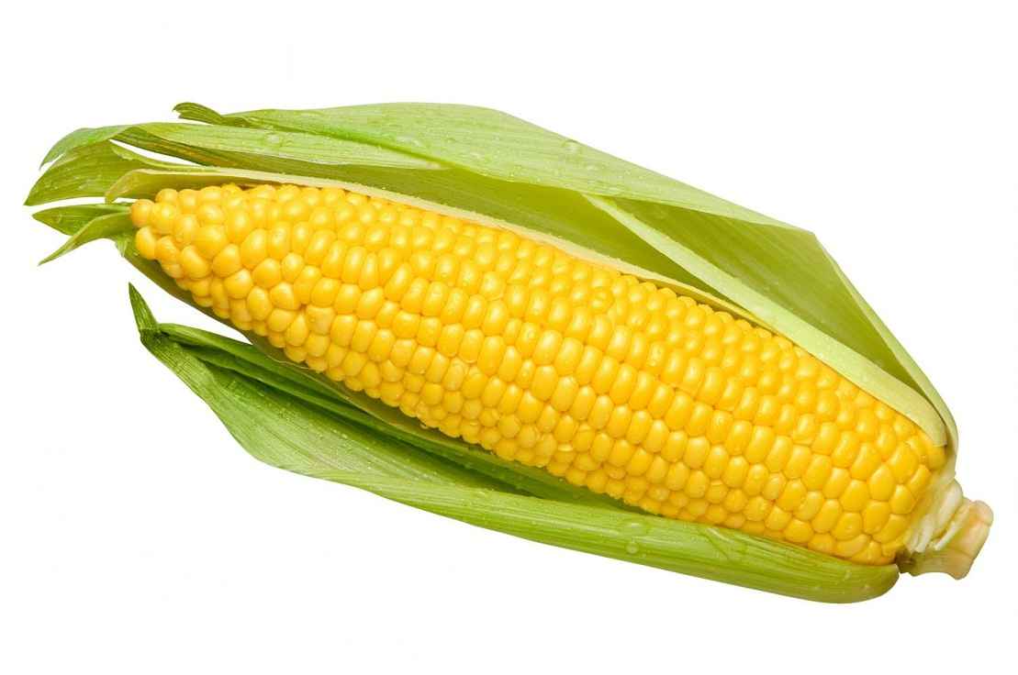
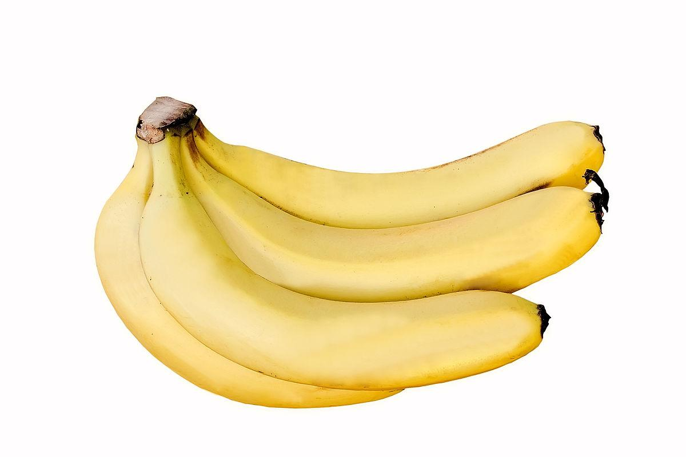
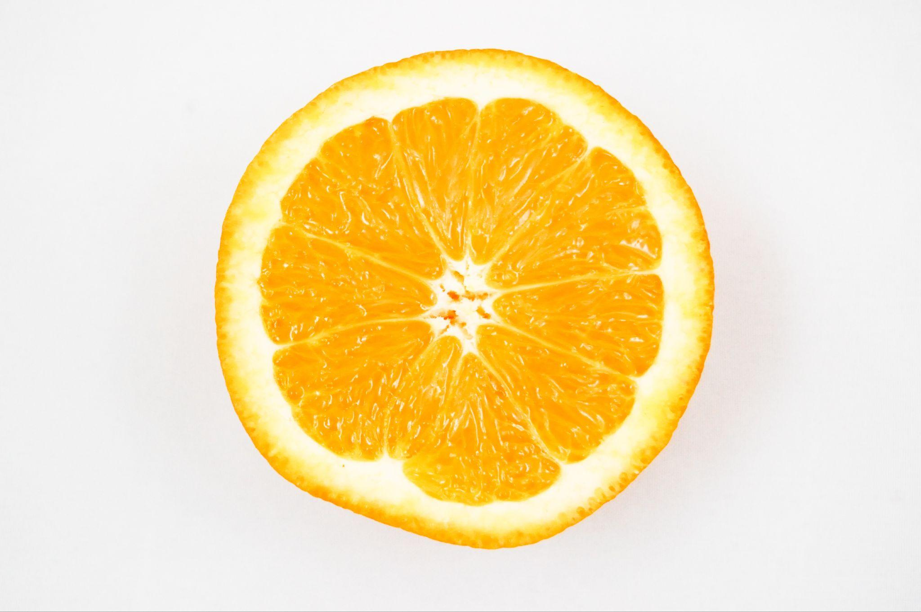
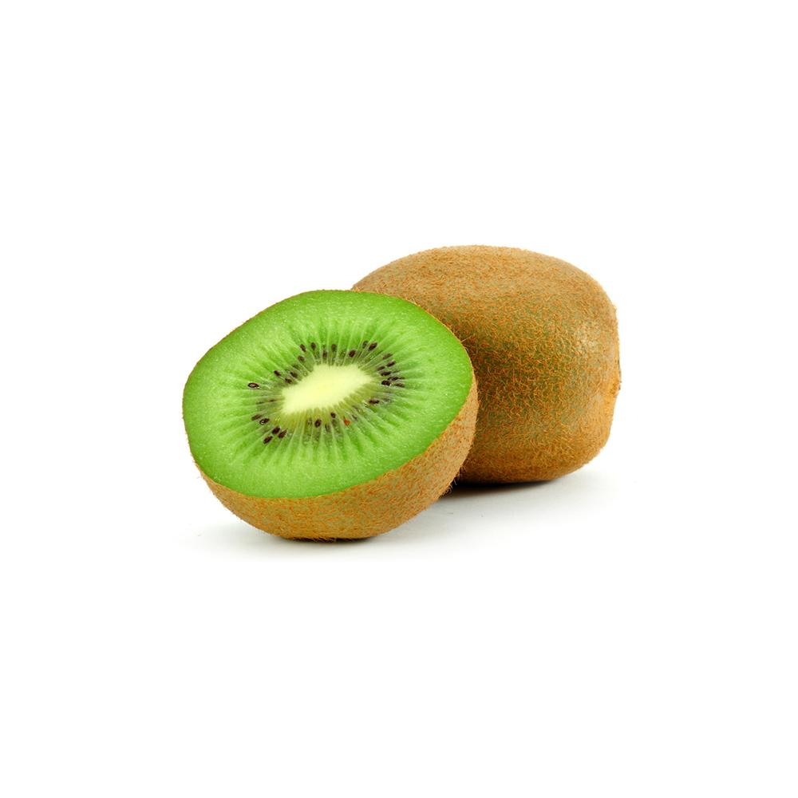
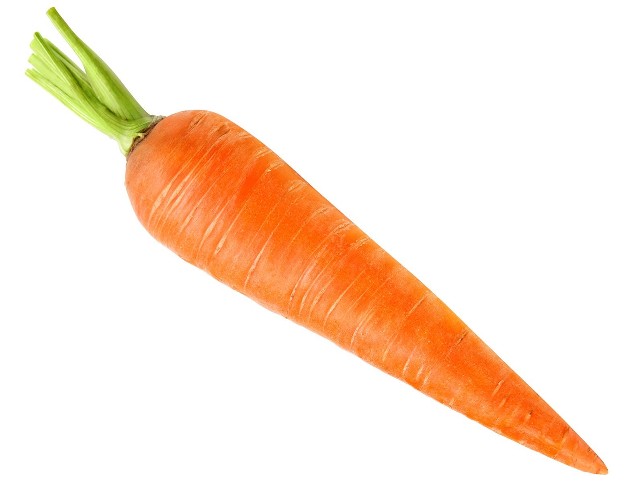
Fruit & Veggie Images w/ Isomap
Fruits (10)
Banana, apple, pear, grapes, orange, kiwi, watermelon, pomegranate, pineapple, mango.
Vegetables (26)
Cucumber, carrot, capsicum, onion, potato, lemon, tomato, raddish, beetroot, cabbage, lettuce, spinach, soybean, cauliflower, bell pepper, chilli pepper, turnip, corn, sweetcorn, sweet potato, paprika, jalepeño, ginger, garlic, peas, eggplant.
Scraped from a Bing Image Search

Slide 20
Code demo

Slide 21
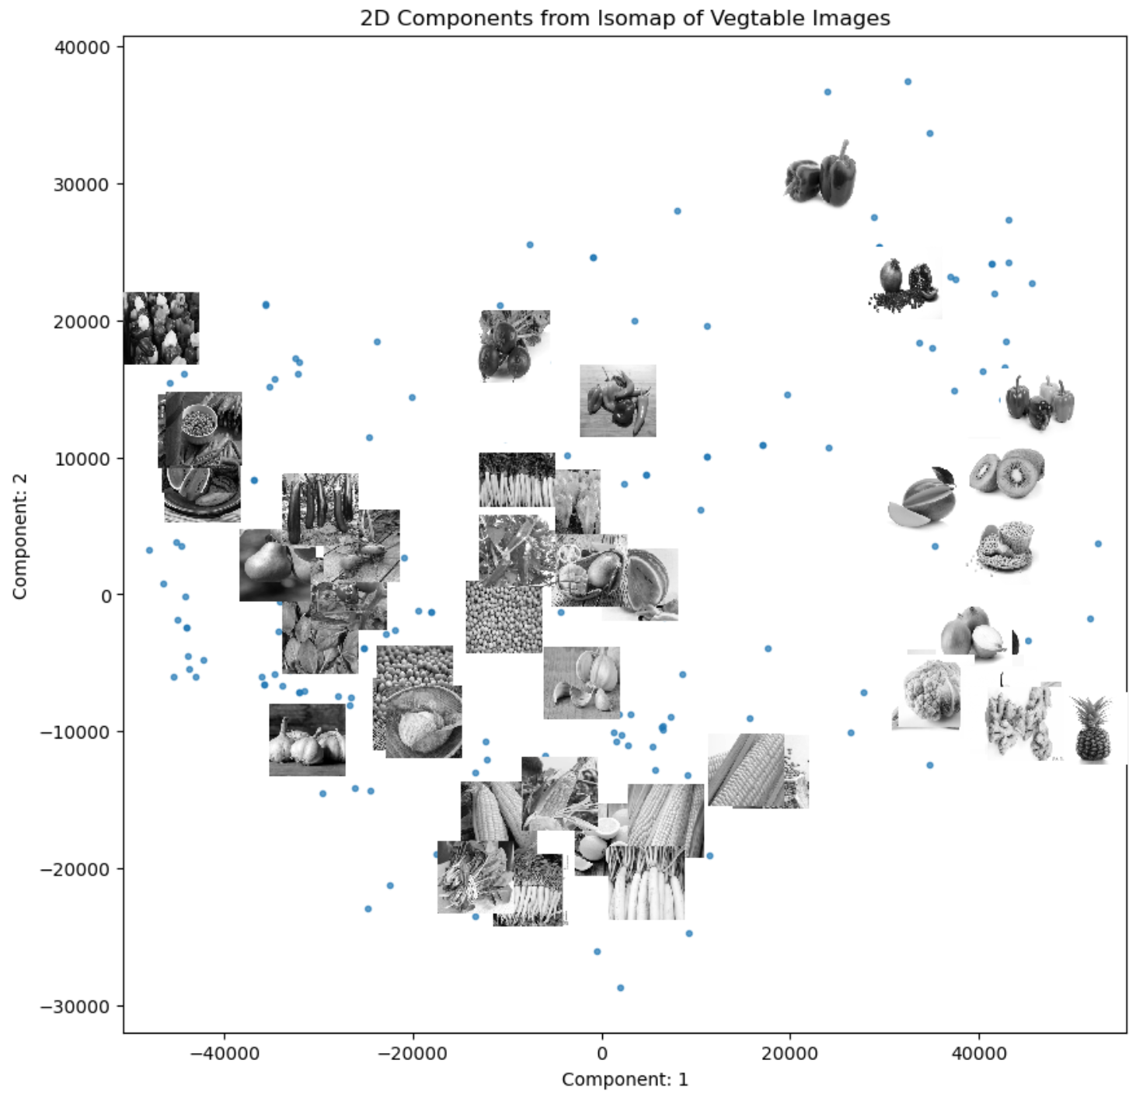

Slide 22
Simulated Data
Real-world Data
Clean
Dirty
Conclusion
Visualizations
Algorithm Showcases
Inconsistent Results

Slide 23
References
Baeldung. “Dijkstra vs Floyd-Warshall Algorithms.” Baeldung on Computer Science, 13 Oct. 2021, www.baeldung.com/cs/dijkstra-vs-floyd-warshall.
Bueno, Luiz. “Rating Opencv Emotion Images.” Kaggle, 4 Dec. 2021,
https://www.kaggle.com/datasets/juniorbueno/rating-opencv-emotion-images?resource=download.
“Isomap with Scikit-Learn.” Solem’s vision blog, 21 Mar. 2012, solem1.rssing.com/chan-7173164/article20.html.
Seth, Kritik. “Fruits and Vegetables Image Recognition Dataset.” Kaggle, 12 Feb. 2022,
https://www.kaggle.com/datasets/kritikseth/fruit-and-vegetable-image-recognition?select=train.
“Sklearn.Datasets.Make_swiss_roll.” Scikit-Learn, scikit-learn.org/stable/modules/generated/sklearn.datasets.make_swiss_roll.html.
“Swiss Roll and Swiss-Hole Reduction.” Scikit-Learn, scikit-learn.org/stable/auto_examples/manifold/plot_swissroll.html#sphx-glr-auto-examples-manifold-plot-swissroll-py.
Tenenbaum, J B et al. “A global geometric framework for nonlinear dimensionality reduction.” Science (New York, N.Y.) vol. 290,5500 (2000): 2319-23. doi:10.1126/science.290.5500.2319

Slide 24
THANKS!
Any questions?

